Slide 1

Docker
What is Docker
Dockerfiles, images, containers
Examples outside AWS
Examples within AWS

Slide 2
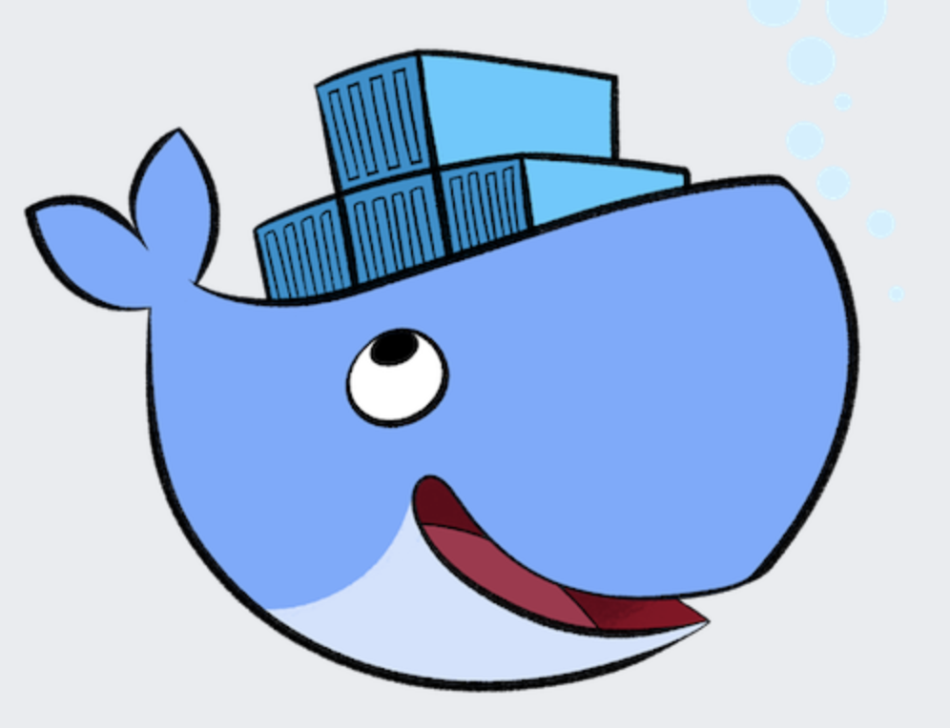
Docker
What is Docker?
Docker is an open platform for developing, shipping, and running applications
Docker allows you to run software by installing just two things:
Docker desktop
Docker image

Slide 3
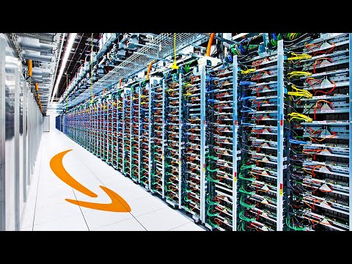
Software packaging options
EC2
EKS
ECS
Fargate
Elastic Beanstalk
API Gateway + Lambda
Lambda
Virtual Machine Image
Docker
Container
Program
(e.g. web service)
function
function
function
function
Notes:
EC2 = Elastic Compute Cloud
EKS = Elastic Kubernetes Service
ECS = Elastic Container Service
Fargate = Amazon's serverless container service --- Lambda does functions, Fargate does containers
EB = Elastic Beanstalk

Slide 4
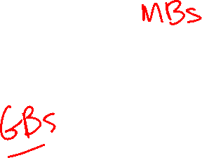
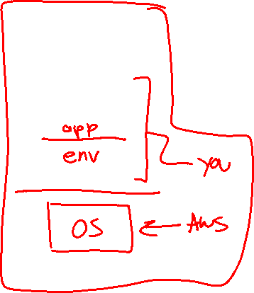
Software packaging options
EC2
EKS
ECS
Fargate
Elastic Beanstalk
API Gateway + Lambda
Lambda
Virtual Machine Image
Docker
Container
Program
(e.g. web service)
function
function
function
function
Notes:
EC2 = Elastic Compute Cloud
EKS = Elastic Kubernetes Service
ECS = Elastic Container Service
Fargate = Amazon's serverless container service --- Lambda does functions, Fargate does containers
EB = Elastic Beanstalk

Slide 5
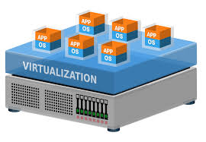
Software packaging trade-offs
✓ Complete control
✓ Consistent environment
✓ HW-enforced separation/security
✘ High space overhead (VM size)
✘ Slow cold start since booting OS (=> slower to scale horizontally)
✓ Consistent runtime environment without overhead of a full VM
✓ Smaller in size => faster cold start (=> faster to scale horizontally)
✘ Less configurable than a VM
✘ Less secure? (SW-enforced)
✘ Apps cannot "see" each other, but can "feel" each other (sharing RAM, CPU)
✓ Easiest to code and deploy
✓ Automatic scaling
✘ Longer latency (response time)
✘ <15 min
5

Slide 6
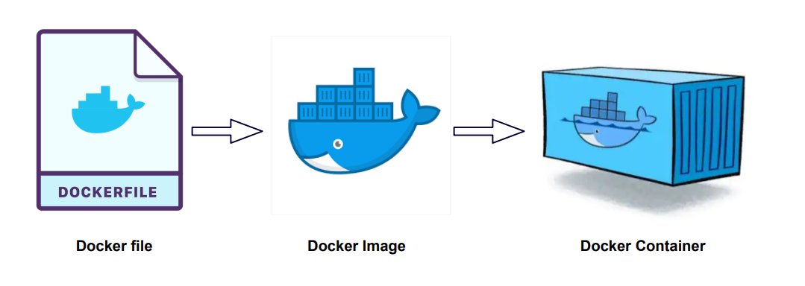
Overview
A Dockerfile is a text document that contains the commands needed to build a docker image
Think of a docker image as a snapshot of the software – a large file that can be stored and shared
Docker Hub is the app store for docker images
A docker container runs a docker image

Slide 7
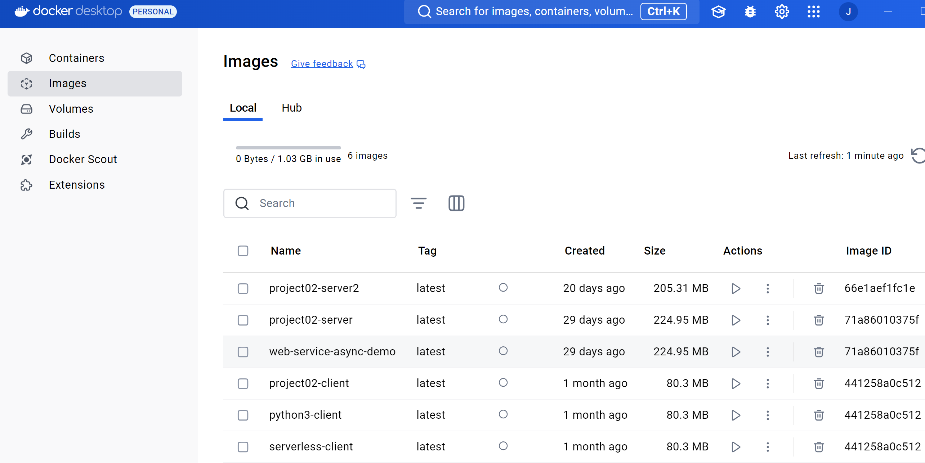
Images vs. Containers
Docker desktop will show your images and containers…

Slide 8
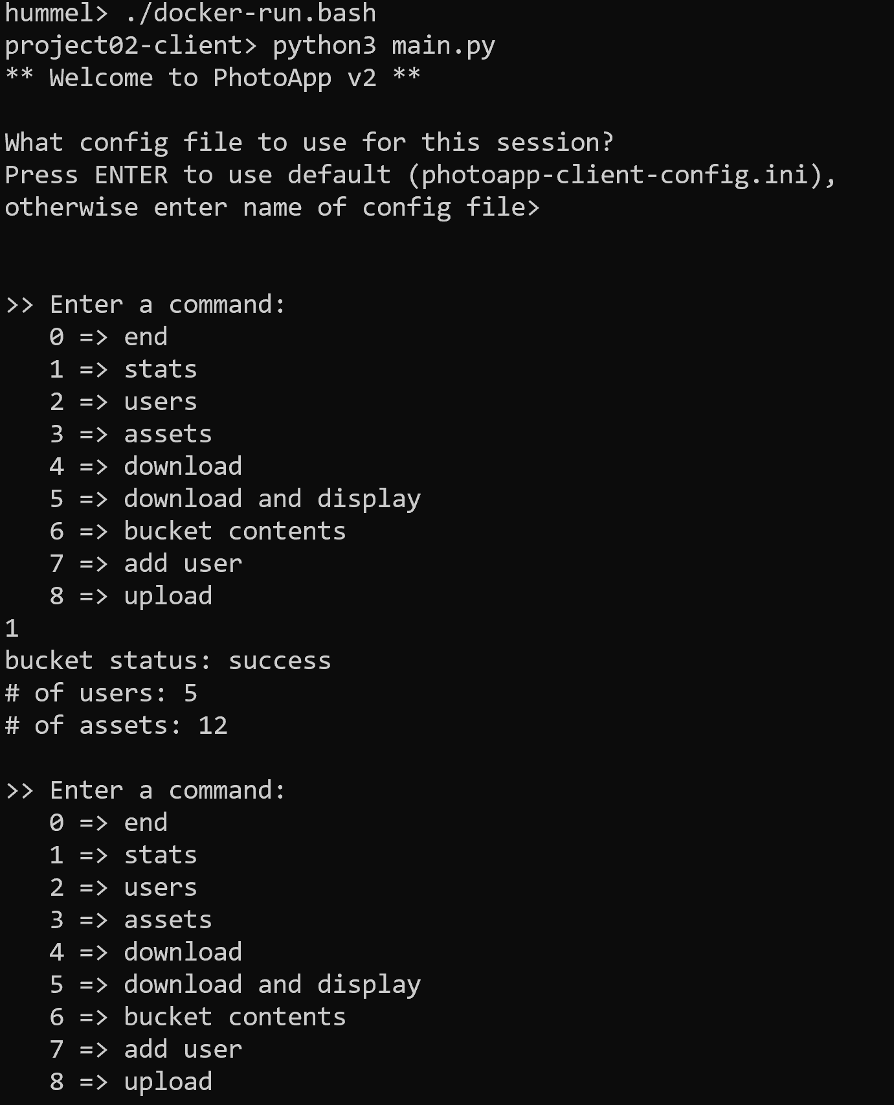
Example #1
Docker containers can run "interactively", allowing user to run & interact with the software:

Slide 9
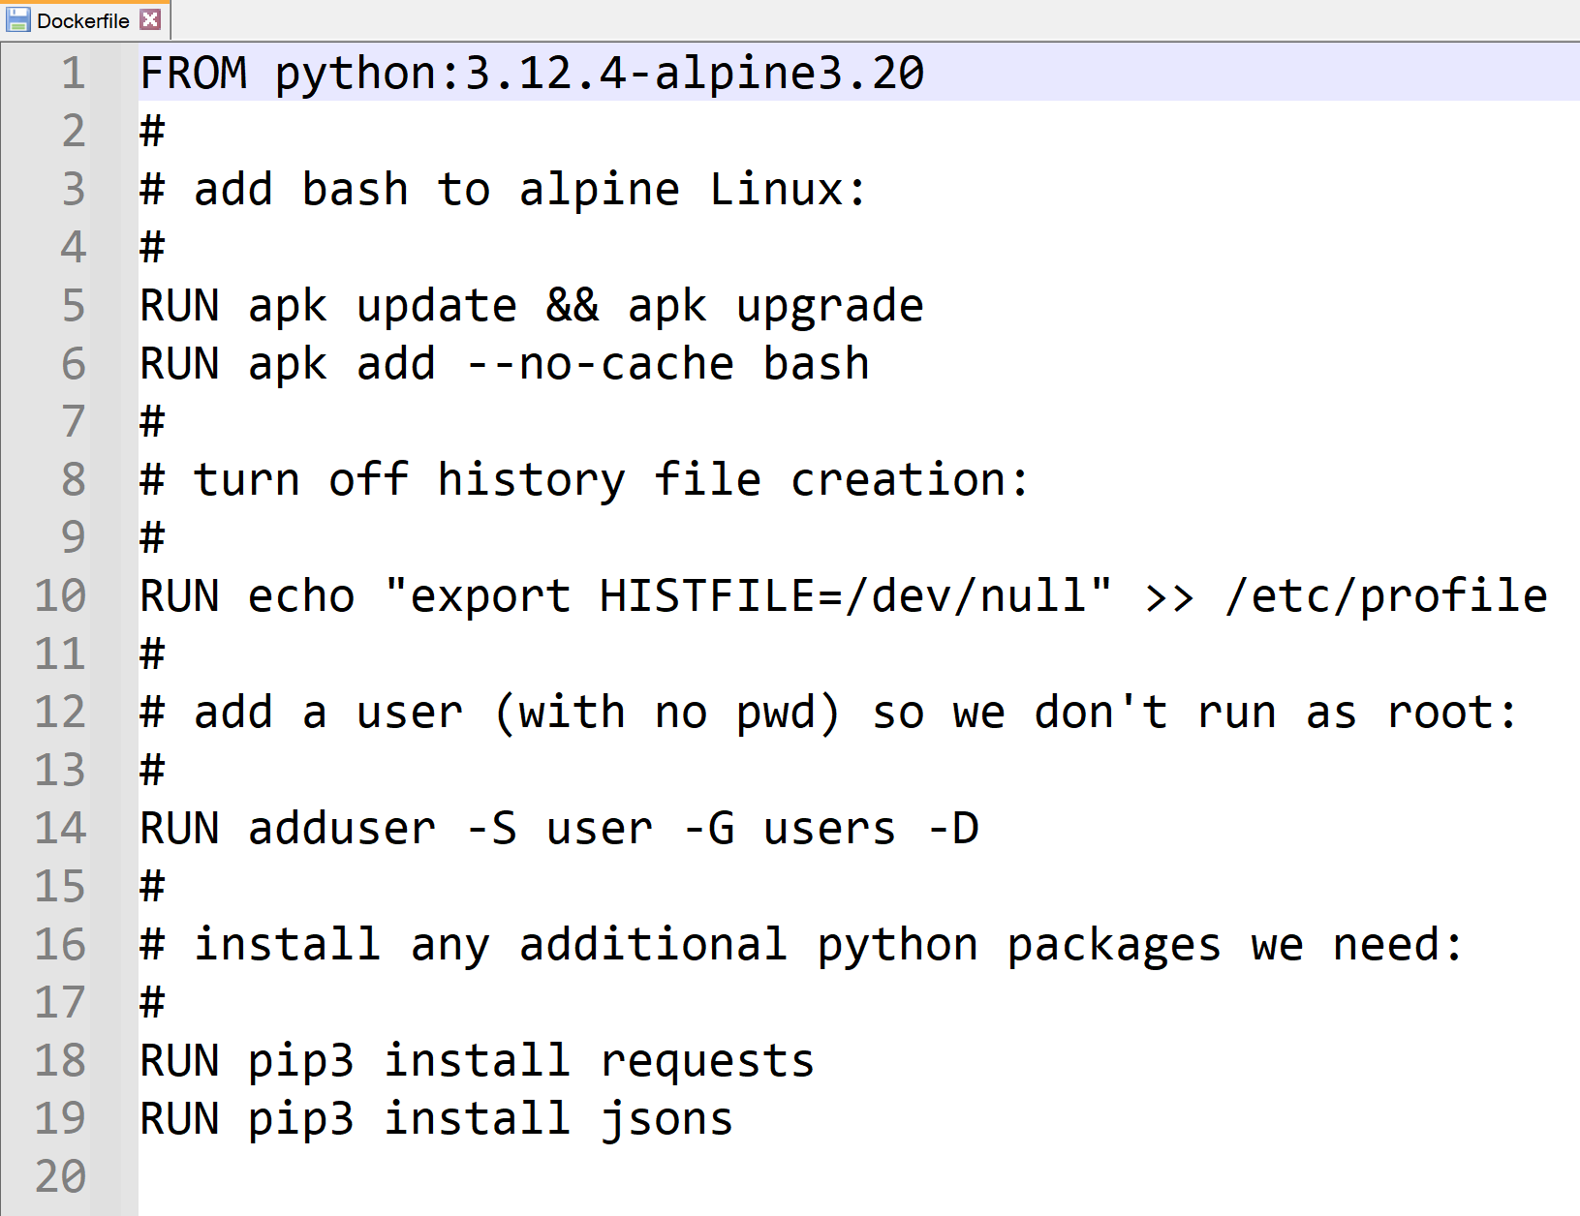
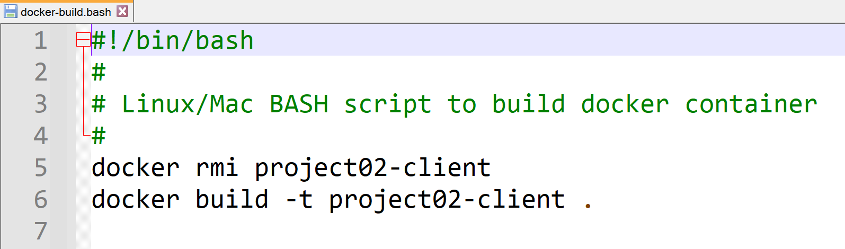
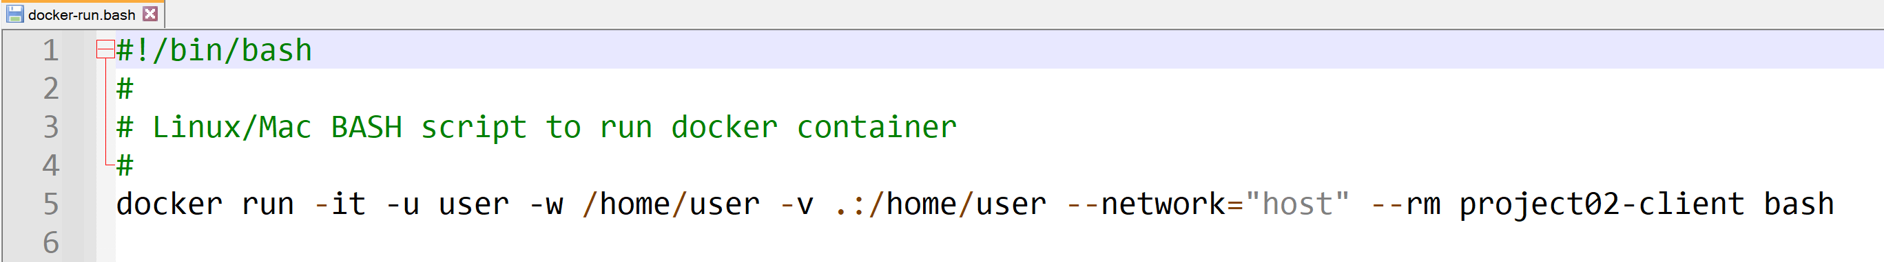
Example #1 files
Notes:
-it => interactive with terminal-like interaction
-u user => run as user (e.g. not as root)
-w => working directory in the container
-v => map the local directory "." to the working directory to gain access to local files that are outside docker container
--network => gain access to local computer's host network
--rm => remove the container upon exiting

Slide 10
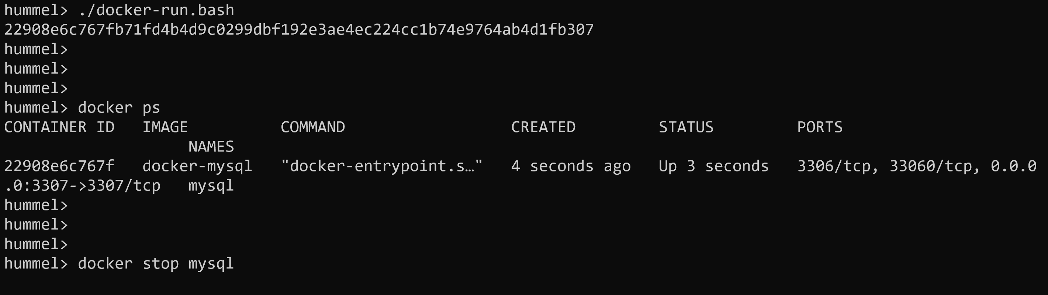
Example #2
Docker containers can run in the background to offer services, e.g. database server or web server

Slide 11
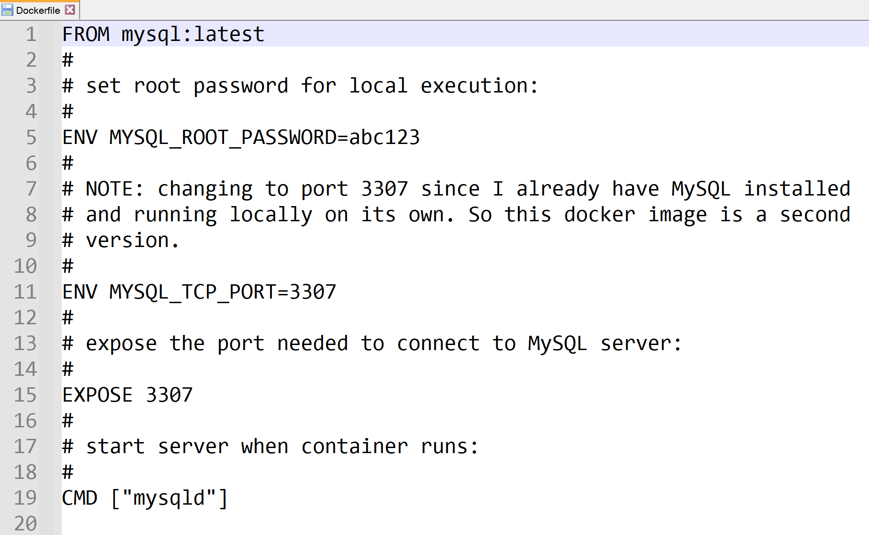
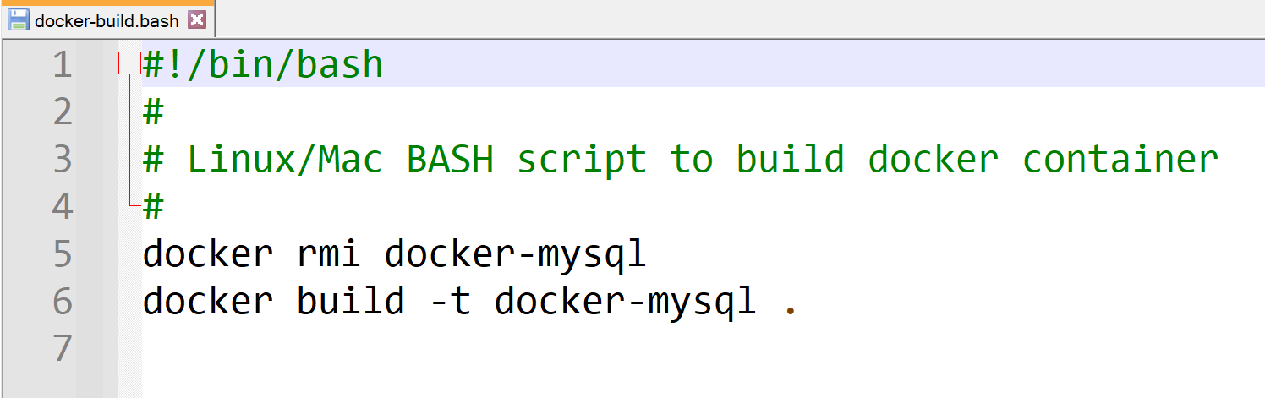
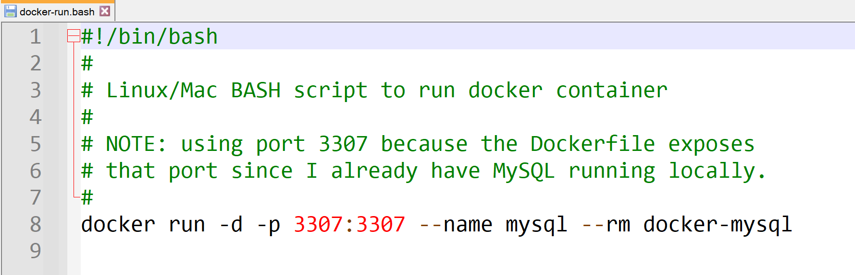
Example #2 files

Slide 12


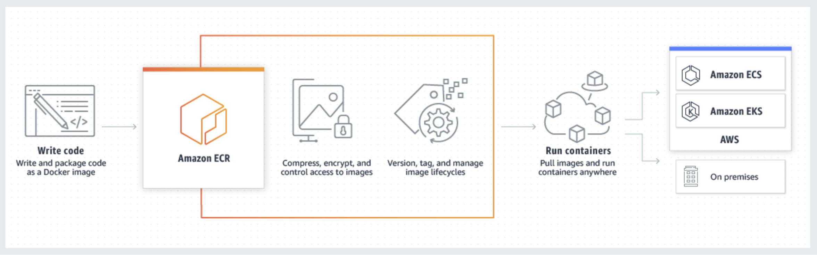
Docker in AWS
Docker images are stored in ECR, and then executed via ECS, EKS, Fargate, or Lambda infrastructure
Amazon ECR
(Elastic Container Registry)
Amazon ECS
(Elastic Container Service)
ECR is AWS’ Docker container registry service that allows developers to store, manage and deploy Docker container images.
Fully managed and integrated with ECS, EKS, Fargate, Lambda, etc. making it straightforward to run containerized applications on AWS.
ECS is a highly scalable, high-performance container orchestration service.
Used to launch and stop container-based applications with simple API calls.
Can be launched on EC2 instances (you manage the server) or on AWS Fargate (serverless).

Slide 13
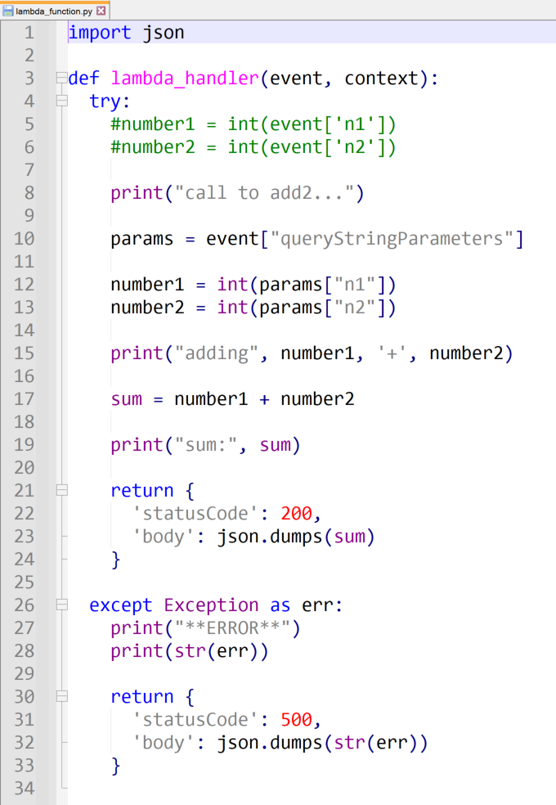
Example #3
Let's run a lambda function using Docker:

Slide 14
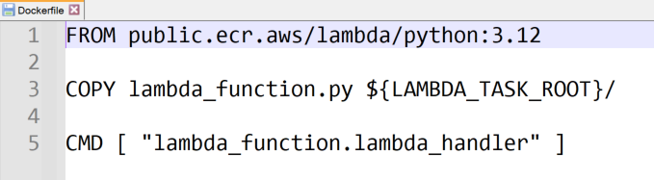
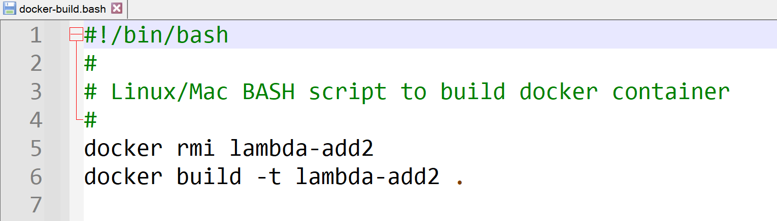
Docker files
Notes:
There's no run for this one, we load into AWS lambda and test from there

Slide 15
Push to ECR, load into Lambda, test
Switch over to AWS:
Search for ECR, open ECR console
Create a repository with same name as container image
Select repository, view "Push command"
Open terminal window on your laptop (AWS CLI must be configured --- we did this in project 01)
Execute each of the "push" commands to push image --- skip the command that builds the image, we did that
Switch to Lambda console
Create new lambda function
Select "Create from Image", and select image from ECR drop-down
Name function and create
Configuration tab: increase timeout
Deploy
Test --- logs are available from CloudWatch, not Lambda console

Slide 16
That's it, thank you!

Slide 17
Docker Commands
Command | Usage | Example
docker run | Start a new container | docker run image_name
docker build | Build a Docker image from a Dockerfile | docker build –t image_name .
docker pull | Pull an image or repository from Docker registry | docker pull ubuntu
docker push | Push a local Docker image to a registry | docker push my_username/image_name
docker images | List all the Docker images stored locally | docker images
docker ps | Shows all running containers. Flag –a shows all containers (running & stopped). | docker ps -a
docker stop | Stops one or more running containers | docker stop container_name
Docker rm | Remove a specific stopped container | docker rm container_id
docker rmi | Remove one or more Docker images | docker rmi image_name

Slide 18
Steps for Building an App with Docker
Define application requirements.
Create a Dockerfile
Start with a base image as the operating system layer for your container
Set the working directory in the container
Copy your application code to the container using the ‘COPY’ command
Add application dependencies using Docker commands like ‘RUN’ to install necessary packages and software
Specify what commands should be run when starting the container using the ‘CMD’ command
Build your docker image based on your Dockerfile
docker build -t app_name .
Test your app running your container locally.
docker run
Push your Docker image to a container registry (like AWS ECR)
docker push app_name
Deploy to a production environment in the cloud choosing a Docker-compatible host (like AWS ECS)

